Slide 1
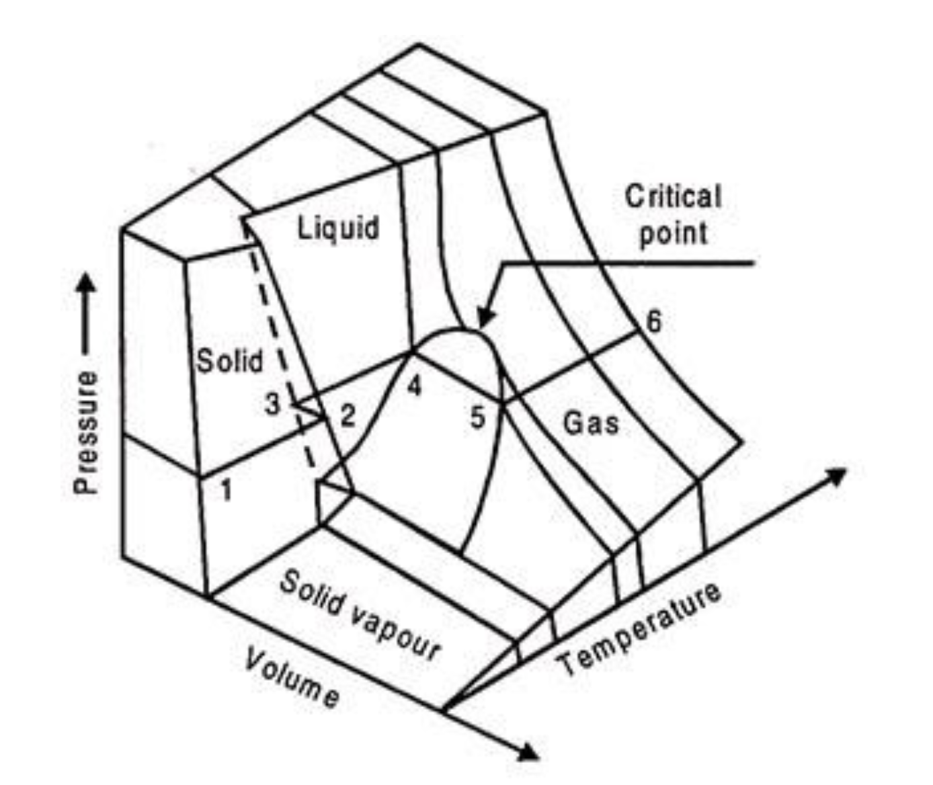
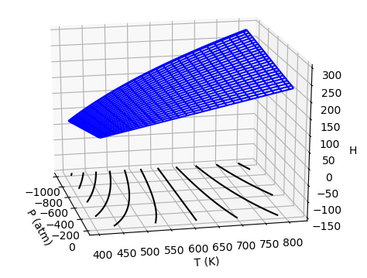
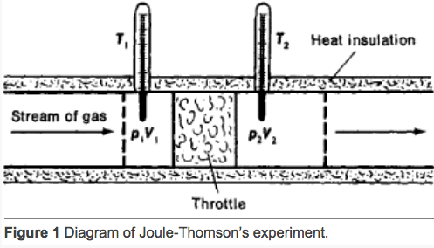
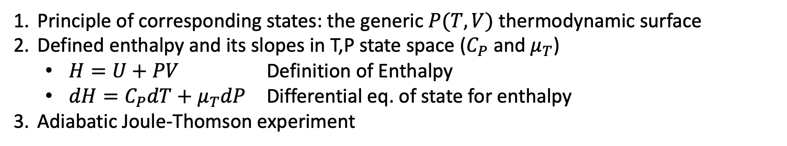
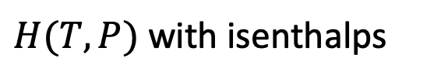

What we’ve done so far this week
Principle of corresponding states: the generic $P(T,V)$ thermodynamic surface
Defined enthalpy and its slopes in T,P state space ($C_{P}$ and $μ_{T}$)
$H=U+PV$ Definition of Enthalpy
$dH=C_{P}dT+μ_{T}dP$ Differential eq. of state for enthalpy
Adiabatic Joule-Thomson experiment
Joule-Thompson experiment
Generic $P(T,V)$
$H(T,P)$ with isenthalps

